Slide 1

England Construction Opportunities
Supporting Individuals into Sustained Employment within the Construction Industry
7th June 2022

Slide 2
Agenda
England Construction Opportunities
Support for sustained employment
Market Engagement Conclusions
Supplier Commitment
CITB Proposal
Timetable
Award Criteria
Delta
Questions

Slide 3


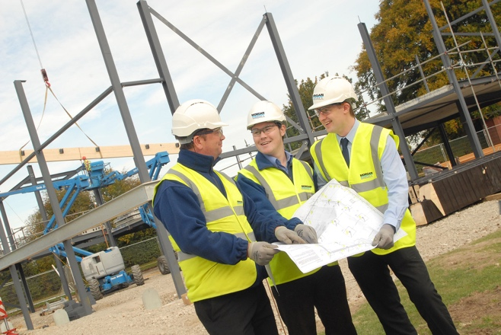
England Construction Opportunities
The new commission is being developed with evaluation findings from the “hub” models and the need for further support and other learning regarding working with new or potential entrants to construction jobs and remaining in the industry
The commission will focus on the journey of a new entrant from the job start, through individual support that helps the retention of the new employee in the industry to attain trade skills and/or higher-level skills, supported by an Employment Support Plan bespoke to the individuals’ needs
Suppliers will engage with local employers to provide job opportunities for the new entrants to construction

Slide 4
Support for sustained employment
Evidence from the CSF and Onsite Experience programmes show that a greater emphasis of individual support post-employment start aids retention in the industry.
CITB wishes to provide further individual support in the workplace for a new employee through a one-year Employment Support Plan. The Employment Support Plan may include:
Job Coaching
Buddy system
Employer (review/support/meetings)
Mentoring

Slide 5
Market Engagement
In April 2022 we held a webinar which helped shape this commission further following a survey:
The commission is for new entrants only, or for those that have not worked in construction for the last 2 years
The fund does not support apprentices
Beneficiaries must be 18+ years
No requirements for the job to be full time
Providers will be split into 2 groups, 100 or less and greater than 100 outputs
Bonus Achievement Payment added

Slide 6
Supplier commitment
Have in place training facilities and/or relationships with other providers to deliver employment and site ready individuals onto the support programme
Ensure all new entrants receive an onsite experience prior to commencing employment
Record current entry level of skills, knowledge and behaviors on the Employment Support Plan to facilitate evaluation of levels of entry and how this effects sustainability in the industry
Skills​ | Communication​ Self-management​
Knowledge​ | Construction-related Health and Safety awareness​
Behaviour​ | Teamwork​ Conforming to general Workplace Health,​ Safety & Welfare Requirements​

Slide 7
CITB Proposal
Funding of £1.82m
1-2 smaller suppliers and 2-3 suppliers of any size with a geographic spread in England
Paid on outputs of job start, 3 and 6 months sustained and evidenced through the Employment Support Plan plus overachievement bonus on 6 months sustained
Destination tracking at 12 months
New funding model to support sustainability with decreasing scales
Providers submitting an application close to an area with an Onsite Experience Hub* will need to detail carefully the demand for construction jobs
*Current Hubs: https://www.citb.co.uk/levy-grants-and-funding/commissioning/live-commissions/
Future Hubs: https://www.citb.co.uk/levy-grants-and-funding/commissioning/current-opportunities/

Slide 8

Onsite Experience Hub Coverage
Location/LEP coverage
Plymouth
New Anglia
Leicestershire
Swindon and Wiltshire
Cheshire
Lancashire
Hertfordshire
GFirst, Heart of the South West, West of England
Thames Valley Berkshire
London

Slide 9
CITB Proposal - Targets
Targets | 22/23 | 23/24 | 24/25 | Total
Experiences (ESR not funded) | 1050 | 1750 | 700 | 3500
Job Starts | 1050 | 1750 | 700 | 3500
Sustained 3 months | 560 | 1400 | 1015 | 2975
Sustained 6 months | 210 | 858 | 867 | 1935
12-month destination report |  | 1 | 1 | 3 (inc 3rd year report)
Target set at 3,500 new job starts spread over 3 years with annual targets set
The supplier will have to demonstrate the upfront training and onsite work experience that leads the new entrant to become ESR through the data reporting of experiences which fall into supplier contribution and commitment to the commission
Based on findings from CSF we decided that it would be reasonable for 85% to still be employed in 3 months.
The aim of the commission is to achieve sustained employment and therefore a target of 65% of those still in employment at 3 months was attributed to the 6 months sustained target

Slide 10
CITB Proposal - Costing Model
Payment milestones | Year 1 unit costs | Year 2 unit costs | Year 3 unit costs
Job start | £140 | £115 | £95
3 months sustained | £210 | £173 | £143
6 months sustained | £350 | £288 | £238
Total Funding | £700 | £575 | £475
Decreasing funding model over 3 years
Largest proportion of payment made at 6 months to encourage sustained employment
Data and project reporting will be paid at 20% of the contract value minus any over achievement bonus

Slide 11

CITB Proposal - Overachievement Bonus
CITB want to incentivise providers to overachieve on sustained employment. Therefore, an overachievement bonus will be paid on the number of individuals who sustain employment for 6 months.
The 6 months KPI is 65% of the job starts who have reached the 3 months sustained employment, move forward and reach the 6 months sustained employment.
The bonus is triggered when the provider achieves over the 65% and up to a maximum of 85%. This bonus will be calculated annually and paid at 3 points specified in the contract.

Slide 12

Timetable
Event | Date
Webinar for tender launch | 7th June 2022
Issue of SQ and request for proposal | 16th June 2022
Deadline for receipt of clarification Requests | 1st July 2022
Tender submission deadline | 18 July 2022
Tender evaluation period | 2nd August 2022
Contract award decision notified to all Tenderers | 8th August 2022
Expiry of standstill | 19th August 2022
Contract award | 1st September 2022

Slide 13
Award Criteria
Scored Question Titles with Weightings
Recruiting for success | 25%
Quality and support | 25%
Working with employers | 25%
Profile of outputs with cost breakdown | 10%
Data reporting and project management | 10%
Sustainability and social value | 5%
Total scored on Quality and Technical Ability | 100%

Slide 14
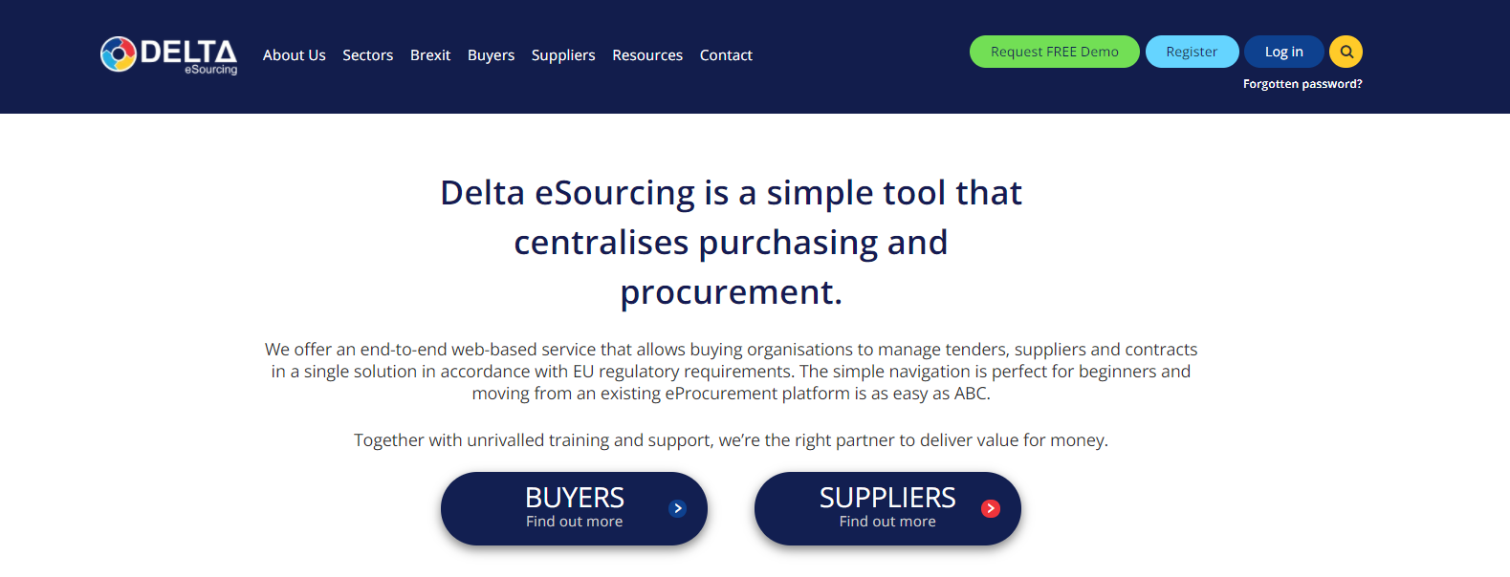
Delta – Creating an account
Procurement, Contract & Tender Management - Delta eSourcing (delta-esourcing.com)

Slide 15
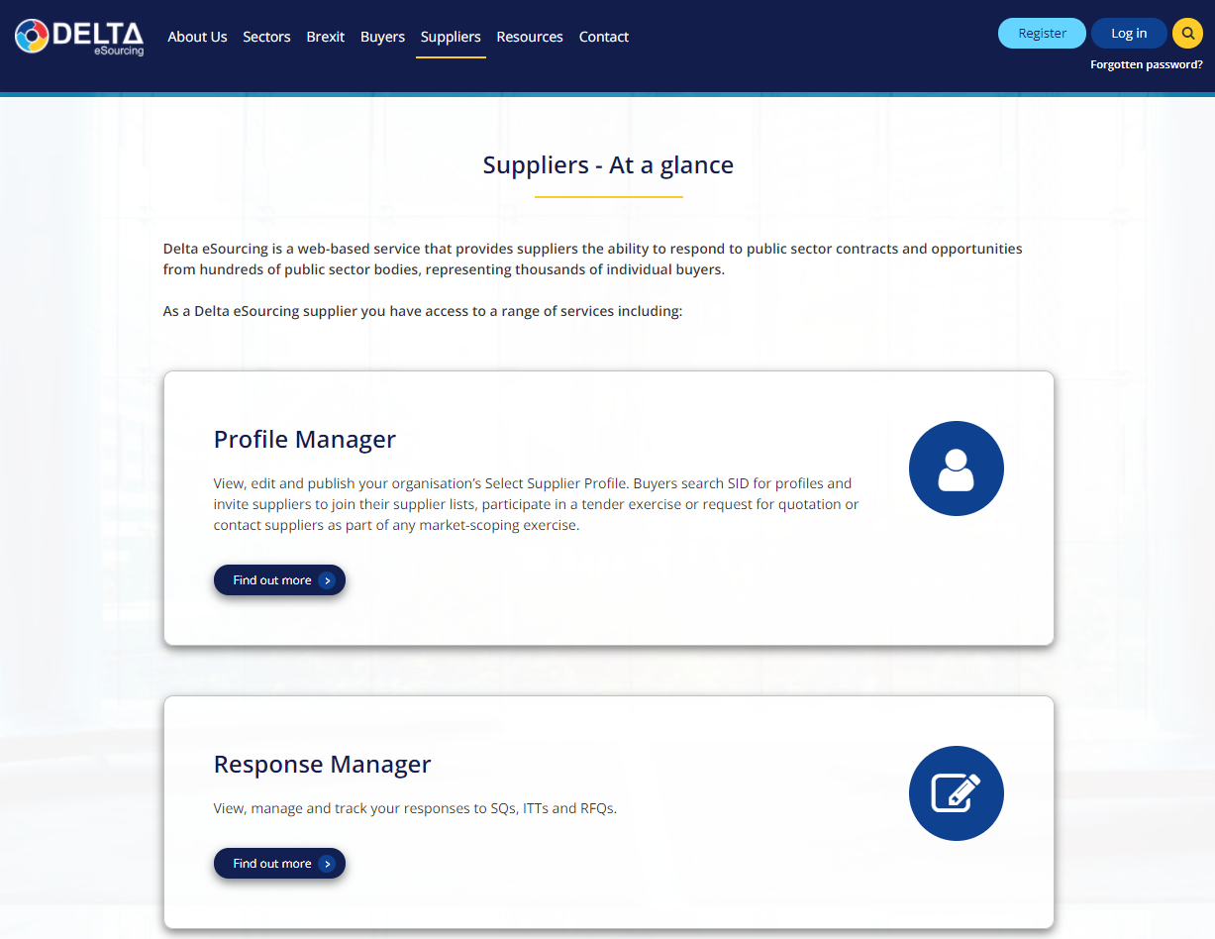
Delta – Creating an account
Register for an account

Slide 16

Delta
Delta access code:
https://www.delta-esourcing.com/respond/B2H2B4R8NT

Slide 17

Supplier Help – Delta
Delta chat facility & helpdesk: 0800 923 9236
Creating a supplier account: https://vimeo.com/412662259/00c7da05e0
Accessing a tender via invitation: https://vimeo.com/412662332/81e77b85ab
Responding to a tender, Stage one, two and three: https://vimeo.com/412662073/e87c9427b2
Message centre: https://vimeo.com/412662458/e55a8b508e
Supplier profile: https://vimeo.com/412662173/bd3315754b
Inviting new users: https://vimeo.com/412662411/60461f5adb
Changing email and password: https://vimeo.com/412662374/57a66ac134
Notes:
Elaine

Slide 18

Any questions?

Slide 19

Notes:
Cheryl

