Slide 1

Launch of Homebuilding Access Training Commission 2025
Thursday 3rd July 2025
This session will commence shortly...

Slide 2

Introduction
CITB Team:
Hannah Gore, CITB Commissioner
Kirsty Woolsey, CITB Project Lead
Dawn Hilliard, CITB Head of Strategy
Suzi Perkins, CITB Commissioner Support
Guidelines for live event:
This event is being recorded
Questions can be submitted via the Q&A box
An FAQ will be created from the questions received
Presentation, recording and FAQ will be shared on the CITB Website after the event: https://www.citb.co.uk/levy-grants-and-funding/funded-projects/current-opportunities/

Slide 3
Agenda
Background to the Commission
CITB Proposal
Timetable
Award Criteria
Central Digital Platform (CDP)
Delta e-sourcing
Guidance
Questions

Slide 4
Background to the Commission
The Homebuilding Mission
The government has announced plans to build 1.5 million new homes by 2029, equating to an annual requirement of 370,000 homes. These targets are ambitious and will generate significant demand for skills and workers.
In order to address this demand, CITB in collaboration with Government and the National House Building Council (NHBC) are investing £140m to establish Homebuilding Skills Hubs.
CITB will be developing 20 Hubs which will aim to deliver two specific strands of training in areas of critical demand for homebuilding:
  Fast Track Apprenticeships
  A short duration high quality training course called Homebuilding Access Training.
  This commission is focussed on the Homebuilding Access Training only.

Slide 5
Background to the Commission
Homebuilding Access Training
CITB estimates that 110,000 people enter the construction industry annually via informal routes. By comparison around 24,000 enter via an apprenticeship.
There is considerable evidence about the barriers to entry through existing training pathways with informal routes proving more accessible than an apprenticeship.
CITB consultation showed broad support for the principle that construction needs additional, more flexible routes of entry and training to meet the needs of different cohorts not attracted to the traditional apprenticeship model.
This evidence coupled with the significant homebuilding skill needs has led CITB to develop the concept of the Homebuilding Access Training Programme.
This commission will test the concept and demand for this type of training which will allow CITB to assess the feasibility, practicality and potential impact before committing to a wider roll-out.
After piloting and testing, the Homebuilding Access Training would become a critical pathway to quickly bring people into jobs and on to further training to support the ramping up of the homebuilding pipeline.
Note: CITB are currently developing the content for a new Homebuilding Access Training Standard. This will be rolled-out if the pilot is successful.

Slide 6
CITB Proposal
Budget £72,500 over 4-month contract period.
Providers to deliver:
  A 4 – 6 week Homebuilding Training Programme delivered to 50 learners, including both New Entrants into construction and Existing Labourers, in at least one of four priority homebuilding occupations:
      Groundworks
      Brickwork
      Drylining
      Timber Frame Erection
  Training Programme to be delivered to:
      15 New Entrants
      35 Existing Labourers
  All learners are required to enrol and complete the training programme

Slide 7
CITB Proposal
  Training programme must already be developed with cohorts ready to commence immediately, with all learners completing training by the end of the 3rd month of the contract duration
  Course content should be at an appropriate level for the target audience and align to relevant occupational standards (National Occupational Standards or Apprenticeship Standards), covering a range of skills/knowledge requirements for one of the four priority homebuilding occupations
  New Entrants are required to obtain a Construction Skills Certification Scheme (CSCS) Labourer card
  Learners entering the programme must be aged 18 or over
  The final month of the project is allocated to receiving the Final Evaluation Report

Slide 8
CITB Proposal
Looking for one provider to deliver in England only
Costs include course delivery, project management, marketing and evaluation costs
Providers have existing relationships with employers on an active housebuilding development in England
Providers have existing relationships with employers and partners to ensure they are engaged in training and consider employment opportunities as an outcome
Qualified trainers with demonstrable experience to deliver these courses (must have access to trainers).
Provider will be introduced to a local CITB New Entrant Support Team (NEST) Adviser, who will provide help with employer engagement, recruitment and post-programme support for learners

Slide 9
Timetable
Event | Date
Supplier Live Event | Thursday 3rd July at 11am
Tender Opens | Thursday 10th July at 11am
Deadline for Receipt of Clarification Requests | Thursday 24th July 2025
Tender Submission Deadline | Monday 11th August 2025
Tender Evaluation | Thursday 21st August 2025
Contract Award Decision and Notification | Wednesday 27th August 2025
Expiry of Standstill | Monday 8th September 2025
Contract Award | September 2025
Project Start | September 2025

Slide 10

Award Criteria
Scored Question Titles with Weightings
Proposed Delivery | 25%
Training | 20%
Engagement | 15%
Quality | 25%
Commercial | 15%

Slide 11
Central Digital Platform - Register
In February 2025, the new Procurement Act came into force changing the rules that shape how public bodies purchase goods and services.
The act creates a simpler and more flexible commercial system, via the Central Digital Platform that allows business to register their details once, and access all Public body procurement opportunities
All suppliers wanting to work with CITB, will need to register on the Central Digital Platform initially to be able to access any tender opportunities, please see the link for this. Find a Tender, the central digital platform
You will receive a unique code when registering on the CDP that you will need when submitting your bid on Delta for any tenders – this is the same code for any future tenders
CITB website links to gov.uk guidance pages: Suppliers (Tendering, Procurement & Frameworks) - CITB

Slide 12

Delta – Creating an account
https://www.delta-esourcing.com/
Register for an account

Slide 13
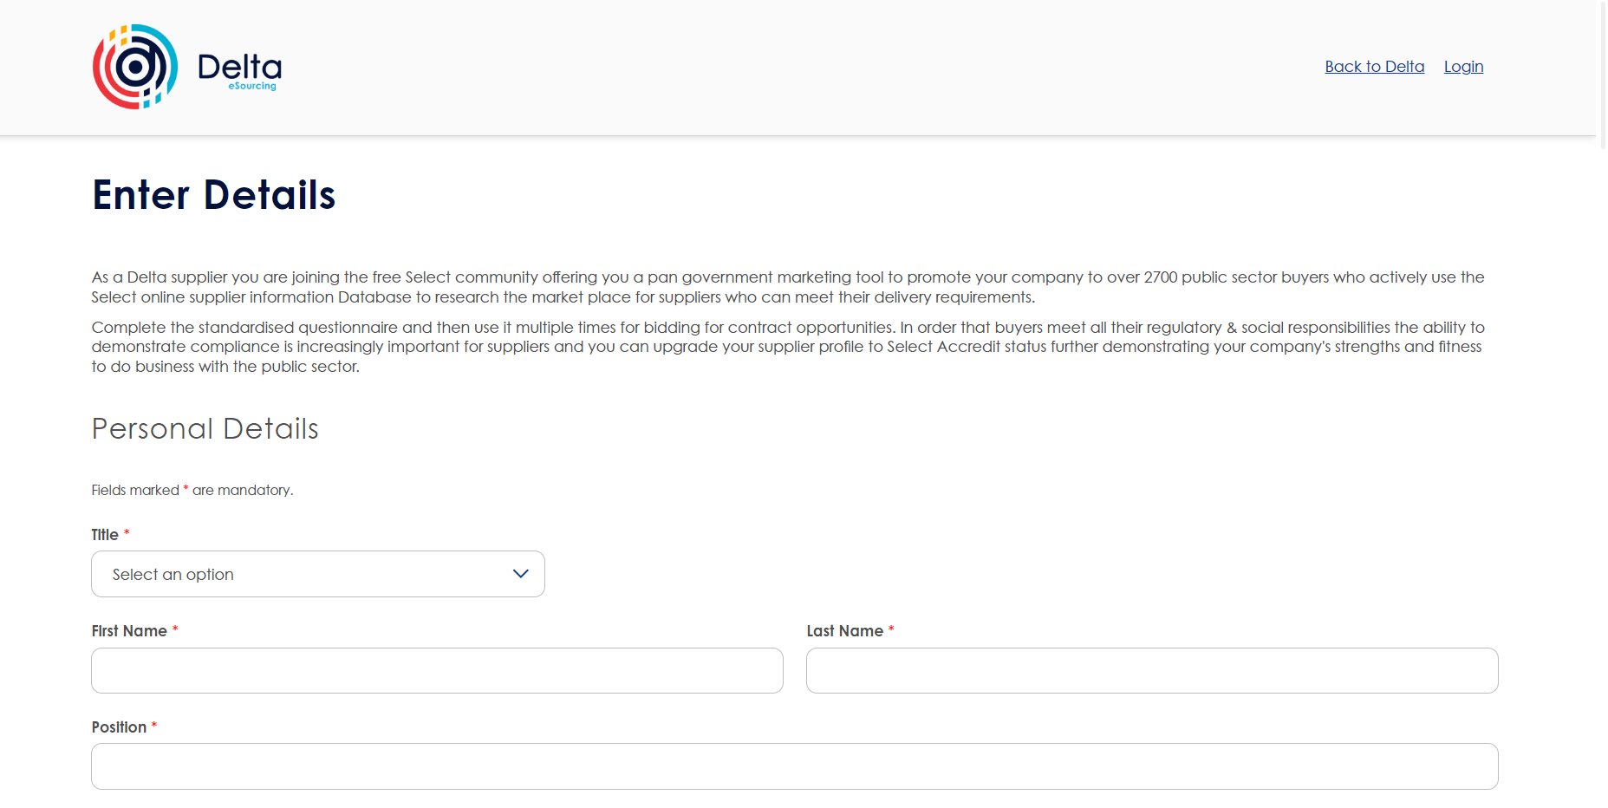
Delta – Creating an account

Slide 14

Delta eSourcing platform
Delta access code:
SGV2U58UBJ
Homebuilding Access Training Commission
CITB website: https://www.citb.co.uk/levy-grants-and-funding/funded-projects/current-opportunities/
Clarification questions may be submitted until 24th July 2025 via the messaging system on Delta

Slide 15
Guidance
Register on the Central Digital Platform (CDP)
Register for a supplier account on Delta
Read all documents included on the tender ensuring your Legal team has reviewed the Terms & Conditions in the Delta documents section
Answer all tender questions - Responses will be scored solely on your submission
Check page limitations – content exceeding limitations will be discounted
Clarification questions via Delta messaging system – questions & responses will be added to the clarifications log and shared with all bidders
Contact Delta for system issues
Questions following event, contact Hannah.Gore@citb.co.uk or Commissioning@citb.co.uk - by Tuesday 8th July

Slide 16

Any questions?

Slide 17


