Slide 1

England Construction Opportunities
Supporting Individuals into Sustained Employment within the Construction Industry
13 April 2022

Slide 2
Agenda
England Construction Opportunities
What we have done so far
Support for sustained employment
CITB Proposal
Supplier Commitment
Questions
What we need from you

Slide 3


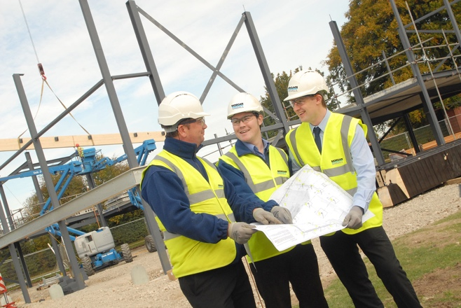
England Construction Opportunities
The new commission is being developed with evaluation findings from the “hub” models and the need for further support and other learning regarding working with new or potential entrants to construction jobs and remaining in the industry
The commission will focus on the journey of a new entrant from the job start, through individual support that helps the retention of the new employee in the industry to attain trade skills and/or higher-level skills, supported by an Employment Support Plan bespoke to the individuals’ needs
Suppliers will engage with local employers to provide job opportunities for the new entrants to construction

Slide 4
What we have done so far
Construction Skills Fund (CSF)
Onsite Experience Commission
Construction Skills Fund (CSF) which was launched in 2018 and funded by DfE, it was designed to provide funding to establish ‘hubs’ to equip individuals for a career in construction
CSF trained individuals in the skills required to become Employment & Site Ready (ESR) to get employment in the construction industry
CITB funded further Hubs through the Onsite Experience Commission in areas not covered by CSF

Slide 5
Support for sustained employment
Evidence from the CSF and Onsite Experience programmes show that a greater emphasis of individual support post-employment start aids retention in the industry.
CITB wishes to provide further individual support in the workplace for a new employee through a one-year Employment Support Plan. The Employment Support Plan may include:
Job Coaching
Buddy system
Employer (review/support/meetings)
Mentoring

Slide 6
CITB Proposal
Funding of £1.82m
1-3 providers with a geographic spread in England to compliment current and future Onsite Experience Hubs
NB There is no requirement for a physical hub
Paid on outputs of job start, 3 and 6 month sustained and evidenced through the Employment Support Plan
Destination tracking at 12 months
New funding model to support sustainability

Slide 7
Supplier commitment
Have in place training facilities and/or relationships with other providers to deliver employment and site ready individuals onto the support programme
Ensure all new entrants receive an onsite experience prior to commencing employment
Record current entry level of skills, knowledge and behaviors on the Employment Support Plan to facilitate evaluation of levels of entry and how this effects sustainability in the industry
Skills​ | Communication​ Self-management​
Knowledge​ | Construction-related Health and Safety awareness​
Behaviour​ | Teamwork​ Conforming to general Workplace Health,​ Safety & Welfare Requirements​

Slide 8
CITB Proposal - Targets
Targets | 22/23 | 23/24 | 24/25 | Total
Experiences (ESR not funded) | 1050 | 1750 | 700 | 3500
Job Starts | 1050 | 1750 | 700 | 3500
Sustained 3 months | 560 | 1400 | 1015 | 2975
Sustained 6 months | 210 | 858 | 867 | 1935
12-month destination report |  | 1 | 1 | 3 (inc 3rd year report)
Target set at 3,500 new job starts spread over 3 years
The supplier will have to demonstrate the upfront training and onsite work experience that leads the new entrant to become ESR through the data reporting of experiences which fall into supplier contribution and commitment to the commission
Based on findings from CSF we decided that it would be reasonable for 85% to still be employed in 3 months.
The aim of the commission is to achieve sustained employment and therefore a target of 65% of those still in employment at 3 months was attributed to the 6 months

Slide 9
CITB Proposal - Costing Model
Payment milestones | Year 1 unit costs | Year 2 unit costs | Year 3 unit costs
Job start | £140 | £115 | £95
3 months sustained | £210 | £173 | £143
6 months sustained | £350 | £288 | £238
Total Funding | £700 | £575 | £475
Decreasing funding model over 3 years
Largest proportion of payment made at 6 months to encourage sustained employment
Additional 20% of contract value allocated to performance management and data reporting

Slide 10

Any questions?

Slide 11
What we need from you
General feedback on the proposed commission. Please complete our short survey by 14th April 2022:
  https://forms.office.com/Pages/ResponsePage.aspx?id=sc0v476-60S-HO9HADhxYyrxbcZmzV1Gr57TqAarT11URFFaN0hSUkM4NDIyOTQ4S09DRUZMVlIwSC4u
  Any support required to access the survey please email commissioning@citb.co.uk

